Slide 1
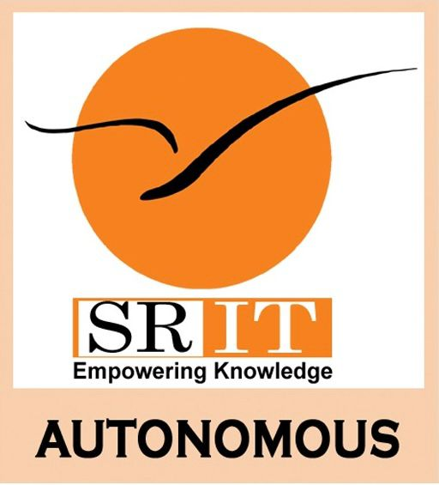
Multimodal Deep Learning Model Integrating CNN and Transformer for Predicting Chemotherapy-Induced Cardiotoxicity
by
S. VARSHA
Roll No. 224G1A05B6
V. DINESH
Roll No. 224G1A0517
C. TABSUM
Roll No. 224G1A05B3
Under the guidance of
Dr. C. Sasikala ,M.Tech,(Ph.D)
Associate Professor & HOD
Department of Computer Science and Engineering (AI&ML)
Srinivasa Ramanujan Institute of Technology
Autonomous
Rotarypuram Village, B K Samudram Mandal, Ananthapuramu – 515701.
2025-2026

Slide 2

Contents
Title Justification
Abstract
Problem statement
Objectives of Project
Literature survey for objectives
Proposed Work -(Methods to be followed for proposed system)
References
GitHub Link

Slide 3
Title Justification
Multimodal → Uses ECG images+ clinical/chemo data to get better predictions.
Deep Learning Model → CNN analyzes images, Transformer analyzes patient data; AI automatically finds patterns.
Integrating CNN & Transformer → Combines image and clinical info for accurate risk prediction.
Predicting Chemotherapy-Induced Cardiotoxicity → Estimates future heart damage from chemo so doctors can act early

Slide 4
Abstract
Chemotherapy-Induced Cardiotoxicity (CIC) is a serious side effect of cancer treatments like Doxorubicin and Trastuzumab, which can cause long-term heart damage and reduce patient survival. Traditional monitoring methods rely on limited clinical data and may detect cardiac issues only after damage occurs. This project proposes a multimodal deep learning system that integrates ECG images (analyzed using CNNs) with clinical and chemotherapy data(analyzed using Transformers) to predict patient-specific cardiotoxic risk early. The system outputs a risk score (Low/Medium/High), enabling doctors to adjust chemotherapy dosage, cycle schedule, and monitoring proactively. By combining spatial and temporal data, this AI-based approach improves prediction accuracy, supports personalized treatment decisions, and helps minimize future heart complications in cancer patients.

Slide 5
Problem Statement
Detecting heart damage caused by chemotherapy is difficult in the early stages because:
Symptoms of heart problems appear late, after damage has started.
Traditional methods cannot predict well who will develop heart problems.
Clinical data and heart images are not analyzed together in current systems.
So, there is a need for a deep learning system that uses both clinical data and images to identify high-risk patients early, before permanent heart damage happens.

Slide 6
Objectives of Project
Develop a multimodal deep learning model that combines ECG images and clinical/chemotherapy data to predict patient-specific cardiotoxicity risk.
Provide an early, patient-specific risk score to help doctors make proactive treatment decisions and reduce future heart damage.

Slide 7
Literature survey for objectives
Study & Year | Dataset / Method | Findings | Gap & Drawbacks
Bouatmane et al., 2024 | Multimodal dataset using TDI images + clinical data, CNN + Transformer/LSTM fusion | Transformer achieved highest accuracy (96%) for early cardiotoxicity detection | Dataset limited; external generalization not validated; needs larger diverse sample
Guo et al., 2020 | CNN-based imaging feature extraction for toxicity monitoring | Deep imaging features help detect subtle myocardial changes | Imaging-only model; no fusion with chemo/clinical data → reduced robustness
Esteva et al., 2019 | Deep learning for cardiovascular disease prediction | Demonstrated improved detection accuracy through AI-driven analysis | Explainability challenges; clinical reliability not fully proven
Zhang et al., 2022 | AI for early cardiotoxicity risk analysis | AI can detect cardiotoxicity before severe EF drop | Single-center dataset; lacks chemo-dose temporal modeling

Slide 8

Proposed System
Patient Data
ECG Images
Clinical+chemo Data
Module 1: CNN
(Image Analysis)
Module 2: Transformer
(Clinical Analysis)
Fusion Layer
Final Risk Classification(Low/Medium/High)
Action

Slide 9
Explanation
Patient details:
ECG → Slight abnormality detected
Drug → Doxorubicin
Age → 65
Diabetes → Yes
Model will show:
Output: High-Risk (78%)
Reason: Age + Diabetes + Doxorubicin weakens heart
Recommendation: Modify treatment or add cardiac protection
Doctor gets warning earlier
Heart failure is prevented

Slide 10
References
Ahmed B., Abdelaziz D., Abdelmajid B. (2024) – Advancements in Cardiotoxicity Detection through AI. IEEE IRASET.
Guo Y., Liu Y., Georgiou T., Lew M.S. (2019) – Deep learning for multimodal data fusion. Neural Computing and Applications, 31, 3905-3919.
Vaswani A., Shazeer N., Parmar N., et al. (2017) – Attention Is All You Need.
Park T., Gupta A., Boulnois N. (2023) – Cardiotoxicity detection using multimodal data fusion. Computers in Biology and Medicine.
Zhou H., Yu Y., Wang C., et al. (2023) – Transformer-based multimodal model for clinical diagnostics. arXiv.
Milosevic M., Jin Q., Singh A., Amal S. (2023) – AI in multimodal imaging for cardiovascular disease. Frontiers in Radiology, 3

Slide 11
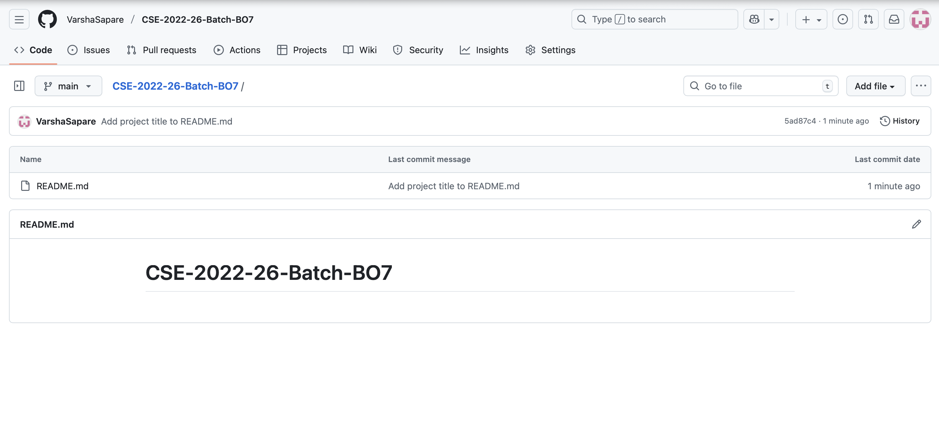
Github Link: https://github.com/VarshaSapare/CSE-2022-26-Batch-BO7.git

